Slide 1


Slide 2
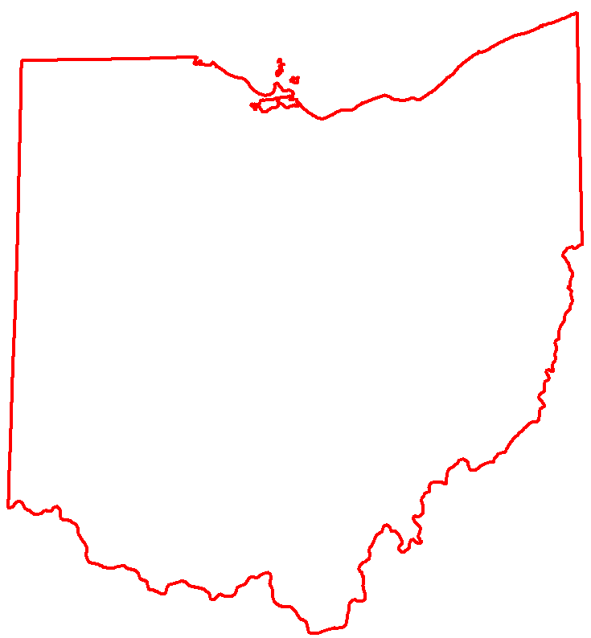
OHIO
Natural and Human Infrastructure
59
mammal species
3 feet of rain
per year
$2.3 Billion Annual Transportation Construction Program
Thousands of parks
2nd largest inventory of bridges in the US
PERLIK
34th in total area in US Development 3,600,000 ac.
  Forest 7,900,000 ac.
  Agriculture 13,600,000 ac.
57,000 + miles of rivers
$1.9 trillion of goods flow
annually through the Ohio’s transportation
system
39 amphibian species
3800 + historic properties on the National Register
483,000 ac. of wetland
$555 billion of goods originate in Ohio
4 National Scenic Rivers
45 reptile species
1 day’s drive of 60% of the US and Canadian population
7th most populated state in
US
8th largest inventory of
public
roads in
the US
2 federally listed bat species
Notes:
Background on the State of Ohio from a land, natural, and cultural resource perspective. Small land size with large amount of people, species, water, historic properties, parklands, and other natural resources. This combined with a massive transportation infrastructure program means inevitable interactions (ie regulations and compliance). ODOT’s projects occur within this matrix of resources and the regulations that protect them. Successful delivery of construction projects requires awareness and execution of the requirements of these regulations

Slide 3
NEPA Assignment
What is the NEPA Assignment Program?
No coordination with FHWA on environmental projects/actions, except for:
  Tribal Coordination
  Projects over state lines
  Program Issues
  Training
  Audit/Performance Measurements
Under the NEPA Assignment program, ODOT assumes all of FHWA's responsibilities for environmental review, interagency consultation, and other environmental related actions in Ohio.

Slide 4
NEPA Assignment
NEPA Assignment Program
New language required on all actions.
New and updated guidance for everything!
Review all the guidance and keep yourself up to speed with the changes.
Faster Project Delivery!
Expected $23 million savings each year!
FHWA responsible for an annual Audit on ODOT’s performance.

Slide 5
Every Project Has Environmental Considerations
More than 45 environmental rules and regulations apply to ODOT’s construction program. Most familiar is the National Environmental Policy Act (NEPA).
Successful delivery of the ODOT program requires adherence to the limitations, allowances, restrictions, and requirements of NEPA and these other laws.
Adherence to or failure to follow these regulations can make or break a project (on time and on cost delivery).
Notes:
Environmental regulation is not an afterthought or something to think about some times. NEPA, and the associated regs and rules that fall under the NEPE umbrella, drives the project delivery decision making.

Slide 6
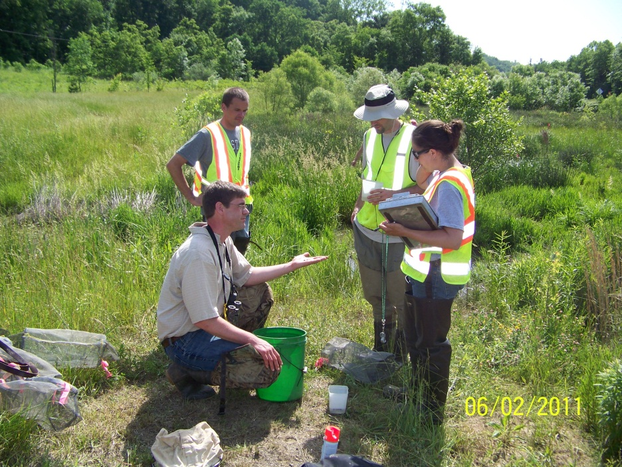
Environmental commitments and how they are accomplished…
Commitments can be implemented by:
  Adherence to Plan notes
  Design changes resulting in changes to plans
  Special Provisions
  Utilizing OES staff, consultants, or contractors (depending on activity) to conduct commitment work prior to construction
  Conducting mitigation/conservation measures
Notes:
ECs can come from CMS (apply to all jobs), programmatic agreements (apply to all jobs), and project specific coordination. All three types or sources of ECs must be followed. The ECF summarizes project-specific ECs and can be a good tool for knowing where they are in the plans. This process of EC compliance is under redevelopment but expect that ODOT will be expecting more from contractors when it comes to assuring compliance.

Slide 7
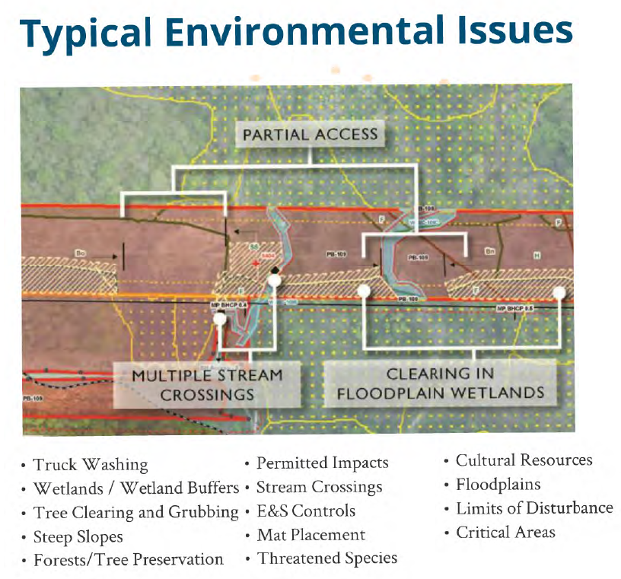


Slide 8
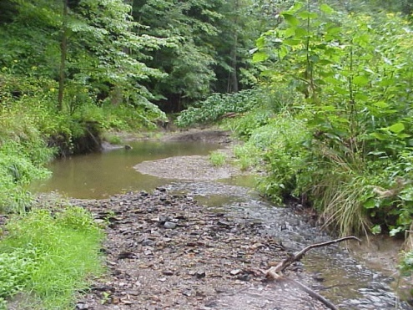
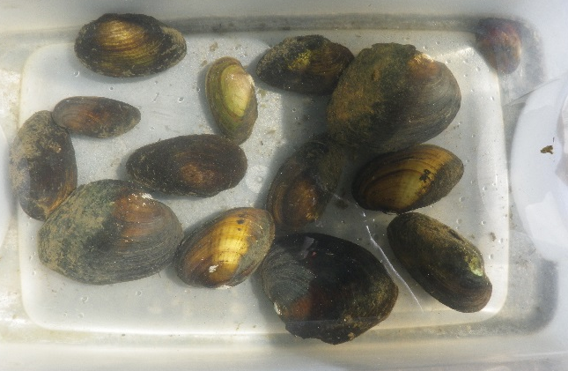
Aquatic Ecology in Ohio
Fishes:
  More than 160 species of fish are found in Ohio’s waters
  Biological indicators of stream health
    Types and abundance can give an indication of water quality and aquatic habitats
Mussels:
  62 species in Ohio
    24 endangered, 4 threatened, 9 species of concern
    Biological indicators of stream health
    Protected by state/fed law and Section 404 of the Clean Water Act

Slide 9
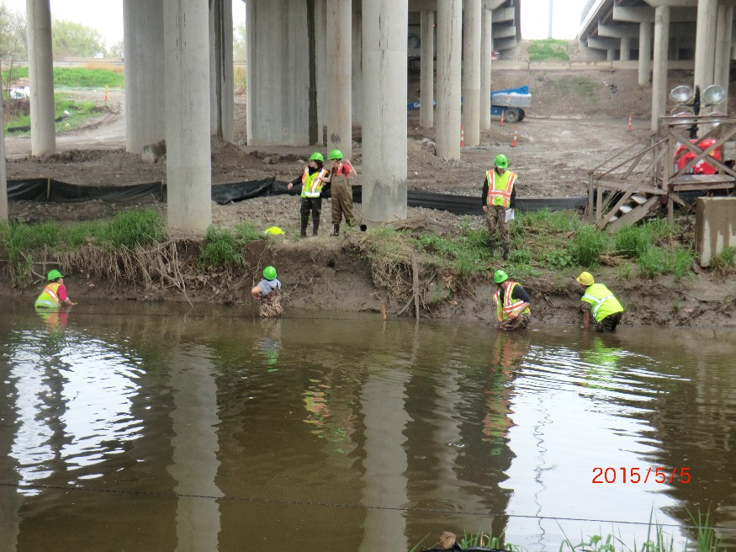
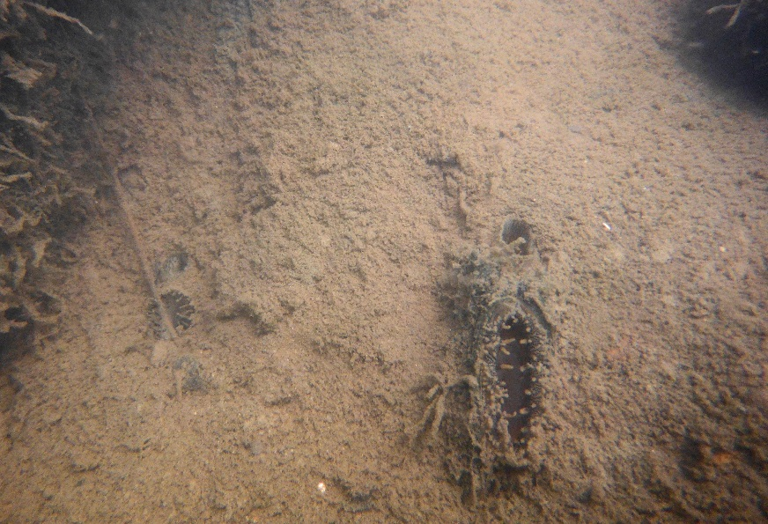
Aquatic Ecology in Ohio
Mussel Sampling:
  Follow the 2016 Ohio Mussel Survey Protocols
    Provides a list of streams divided into 4 groups
    Groups 1 and 3 streams are not known to contain federally listed species
    Groups 2 and 4 streams are historically or currently have records for federally listed species
    Several Ohio streams are not listed
  Reconnaissance survey required on every stream >10 mi² not on the list and for Group 1 streams.
  Survey work may only be conducted between May 1 and October 1 during normal water conditions unless otherwise approved by ODNR/USFWS.

Slide 10
Federally Listed Mussel Considerations
Project schedules may require additional time and environmental commitments.
Mussel surveys and relocations may be required, and can only be done between May 1 and October 1, unless an exception is granted by ODNR and/or USFWS.
To avoid formal consultation with USFWS, bridges may need to be re-designed to avoid in-stream work.
If formal consultation cannot be avoided, processing of the BA and BO can take up to 180 days, plus time to prepare reports.
Additional coordination may be needed to work out BMPs and construction timing to reduce possibility of impact to listed mussels.
  May require collection of waste water.
  May require silt fence or other storm-water BMPs, even on projects with less than one acre of land clearing.
  May require exclusion fencing or other methods to delineate areas to avoid.
  May require construction to occur during the low-flow period of the year.
  Agencies often request to be invited to the pre-bid and pre-construction meetings.
  Agencies often visit these sites to ensure compliance.

Slide 11
Typical Commitments
Demarcating project limits and adjacent aquatic resources to avoid unintended impacts
Use of native grasses and wildflowers for revegetating disturbed areas
Depressed culvert inverts that allow for the free passage of aquatic fauna on new crossings
Erosion and sedimentation control

Slide 12
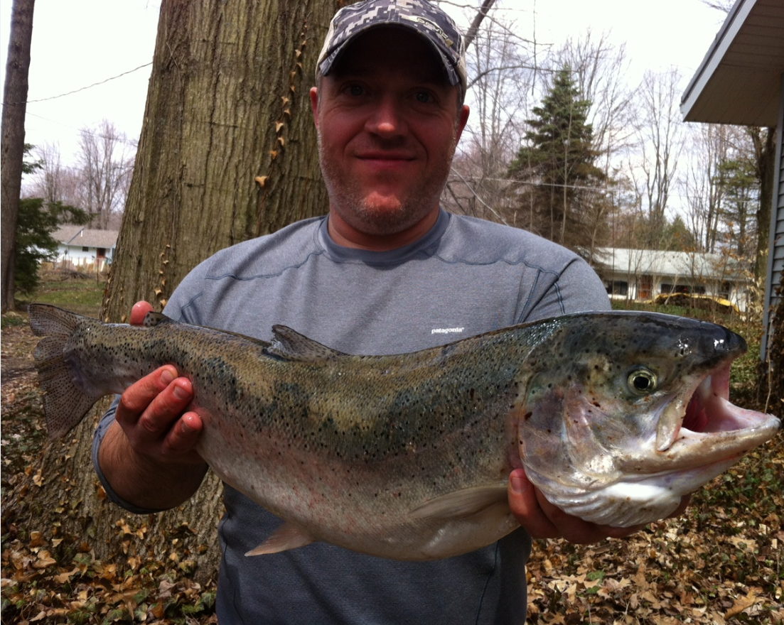
So why is this important?
It’s the law.
Failure to follow the law:
  Fines/Violations
  Loss of Federal funds $$
  Jail/Criminal charges
Would you rather catch this?

Slide 13
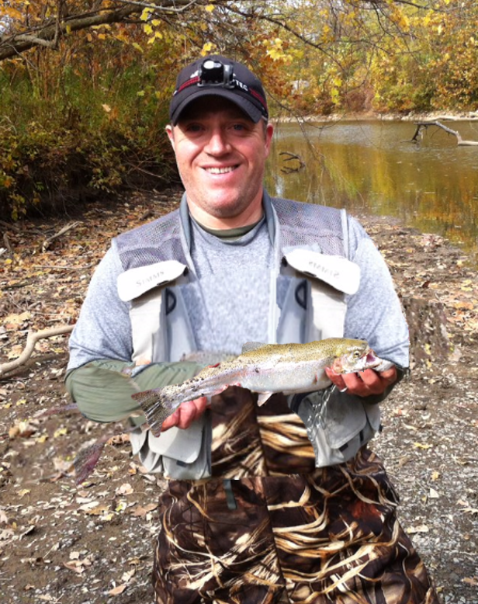
So why is this important?
Suspended solids:
  reduce sunlight penetration needed for aquatic plants, reduce survival rates for fish eggs, interfere with fish feeding habits, and
  clog and damage fish gills which increases risk of infection and disease.
Sediment deposits:
  destroy fish spawning areas, resulting in the loss of sensitive or threatened fish species, adversely impact aquatic quality.

Slide 14

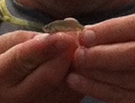
So why is this important?

Slide 15
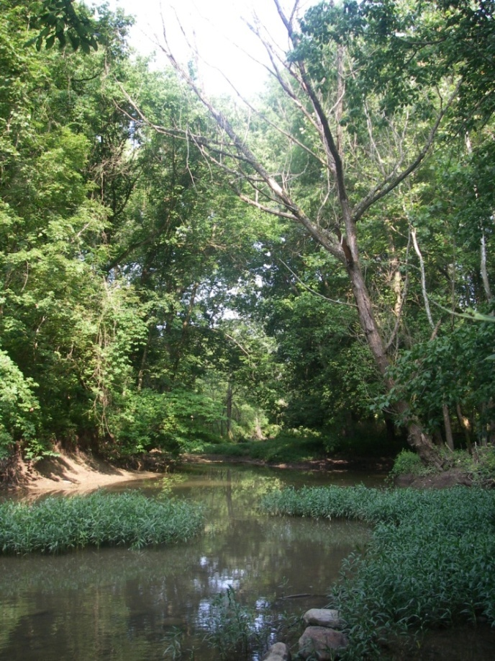
Indiana Bat/NLE Bat Habitat Characterization
Suitable Wooded Habitat
  Any tree covered area that is 0.5 ac or larger, containing any potential roosts (i.e., live trees and/or snags ≥3 inches dbh that have exfoliating bark, cracks, crevices, and/or cavities) greater than 13 ft tall and at least 3 in dbh
Dead snag with peeling bark near Big Darby Creek.

Slide 16
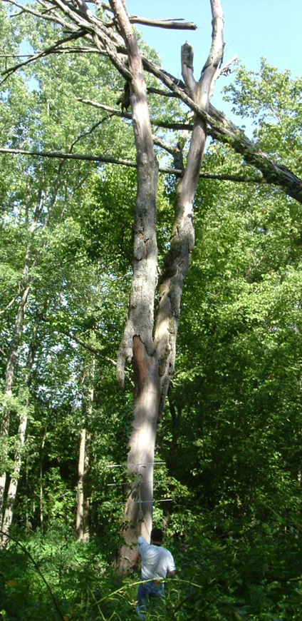
Potential Maternity Roosts
Large Trees, 16” dbh or larger
Solar Exposure
Limbs with habitat, 8” dia.
Located in woodlots or fence rows or within 1000 feet of wooded areas.
Will only need to identify PMRTs when tree removal will occur greater than 100 feet from the roadway or if we can’t meet the cutting restriction dates.

Slide 17
Indiana Bat/NLE Bat Habitat Characterization
Suitable Wooded Habitat
  Any tree covered area that is 0.5 ac or larger, containing any potential roosts, OR any patch of trees with these characteristics that is less than ½ acre in size but is within 1,000 feet of a Potential Maternity Roost Tree (PMRT) or any patch of wooded riparian buffer.
  It is important to note that the entire tree covered area – i.e., all trees, not just the trees with roost characteristics – are considered SWH if this definition is met.

Slide 18
Typical Commitments
Seasonal cutting of suitable wooded habitat to protect listed bats
  All tree clearing will occur only between October 1 and March 31 (or between November 15 and March 15 in RED buffer areas).
  Preserving bat habitat as a conservation measure
  Recent project in central Ohio cost ODOT $1.4 million in mitigation due to failure to clear a few acres of trees during the cutting period!
Stream and wetland mitigation
Removal of only vegetation necessary for construction

Slide 19
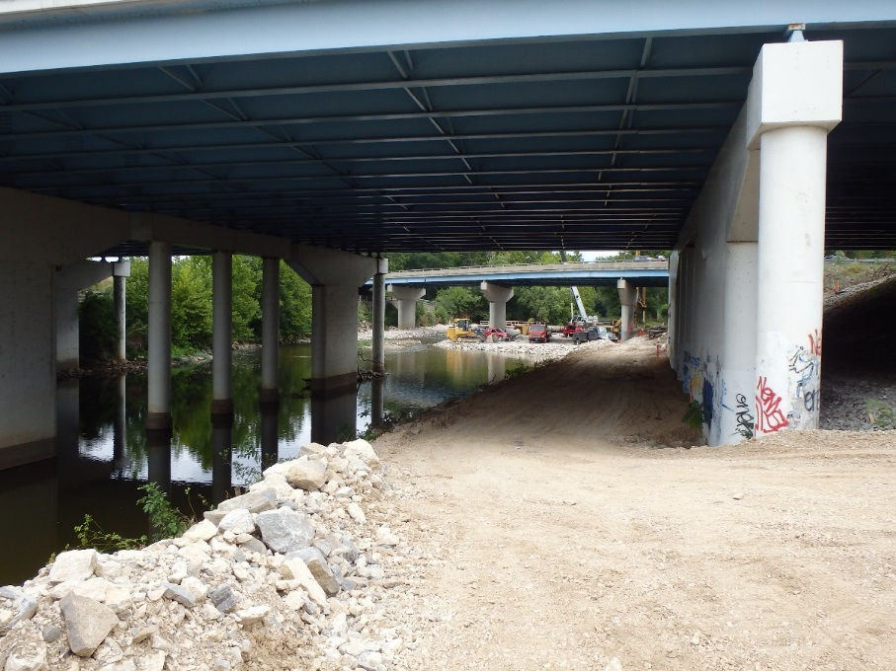
404/401 Compliance
    Problems Continue…..
    Plans changing after permitting process and new impacts not re-coordinated with OES (i.e., RCP, temp fill)
    Not enough space for construction access and staging (constructability reviews)
    Temporary BMPs

Slide 20
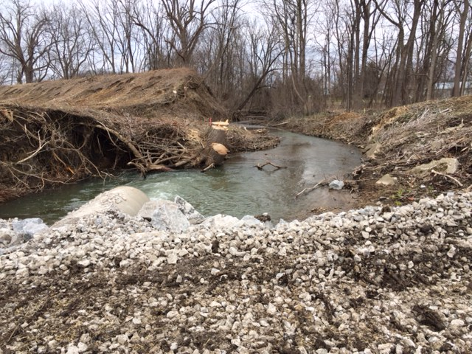
404/401 Compliance
    Problems Continue…..
    No BMPs with tree clearing contract…ACOE watching this closely
    Erodible causeways/work pads

Slide 21
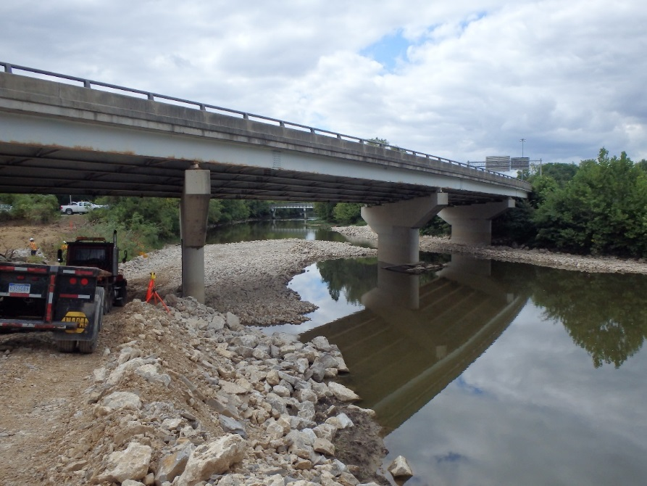
404/401 Compliance
404/401 Compliance: what more can we do?
  Coordinate with OES prior to changes to impacts: Communication between construction & DEC
  Constructability reviews: Focus on large stream/rivers & tight work limits
  Environmental inspection and compliance monitor.

Slide 22
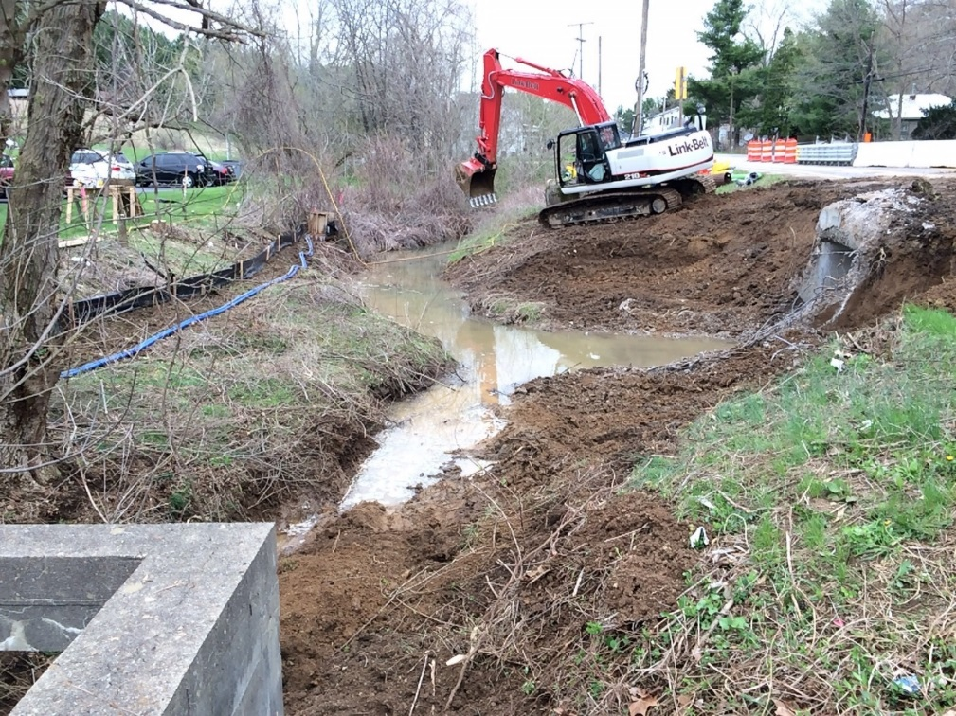
404/401 Violations
  Can result in work stoppage
  Cost an average of $1.25 million per violation (fines, studies and mitigation).
  Impact ODOT’s ability to advance the next construction project.
  Recent ODOT violations resulted in criminal investigations by USEPA, OEPA and Ohio Attorney Generals Office.

Slide 23
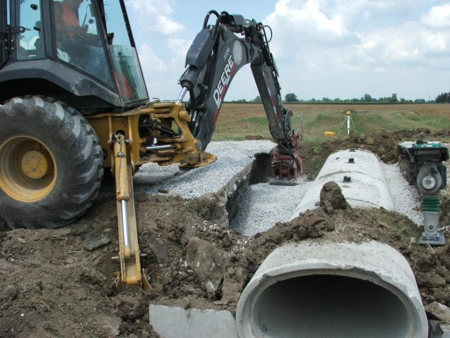
ODOT's Special Provisions Package
Special Provisions are the method ODOT uses to include the waterway permits conditions as part of the construction contract.
The SPP prepared by OES-WPU contains the following:
  Project specific title sheet
  Standard/project specific conditions/provisions
  Water resource tables, figures, and plans that the agencies approved

Slide 24
ODOT's Special Provisions Package
Special Provisions ensure that the contractor is aware of all Waterway Permit Conditions prior to bidding on a construction contract.
  Contractor must adhere to all of the conditions since they are now part of the contract.
The permit is sent at the same time as the SPP, but is NOT to be attached to the construction plans.
Any permits must be provided to the contractor and displayed at the project site.

Slide 25
ODOT's Special Provisions Package
USACE and Ohio EPA reserve the right to inspect any ODOT project during or post construction.
If compliance issues arise, OES works with the district office to address as soon as possible, which may involve a consultant.
If the contractor is responsible for non-compliance, ODOT will hold the contractor liable per the construction contract.

Slide 26
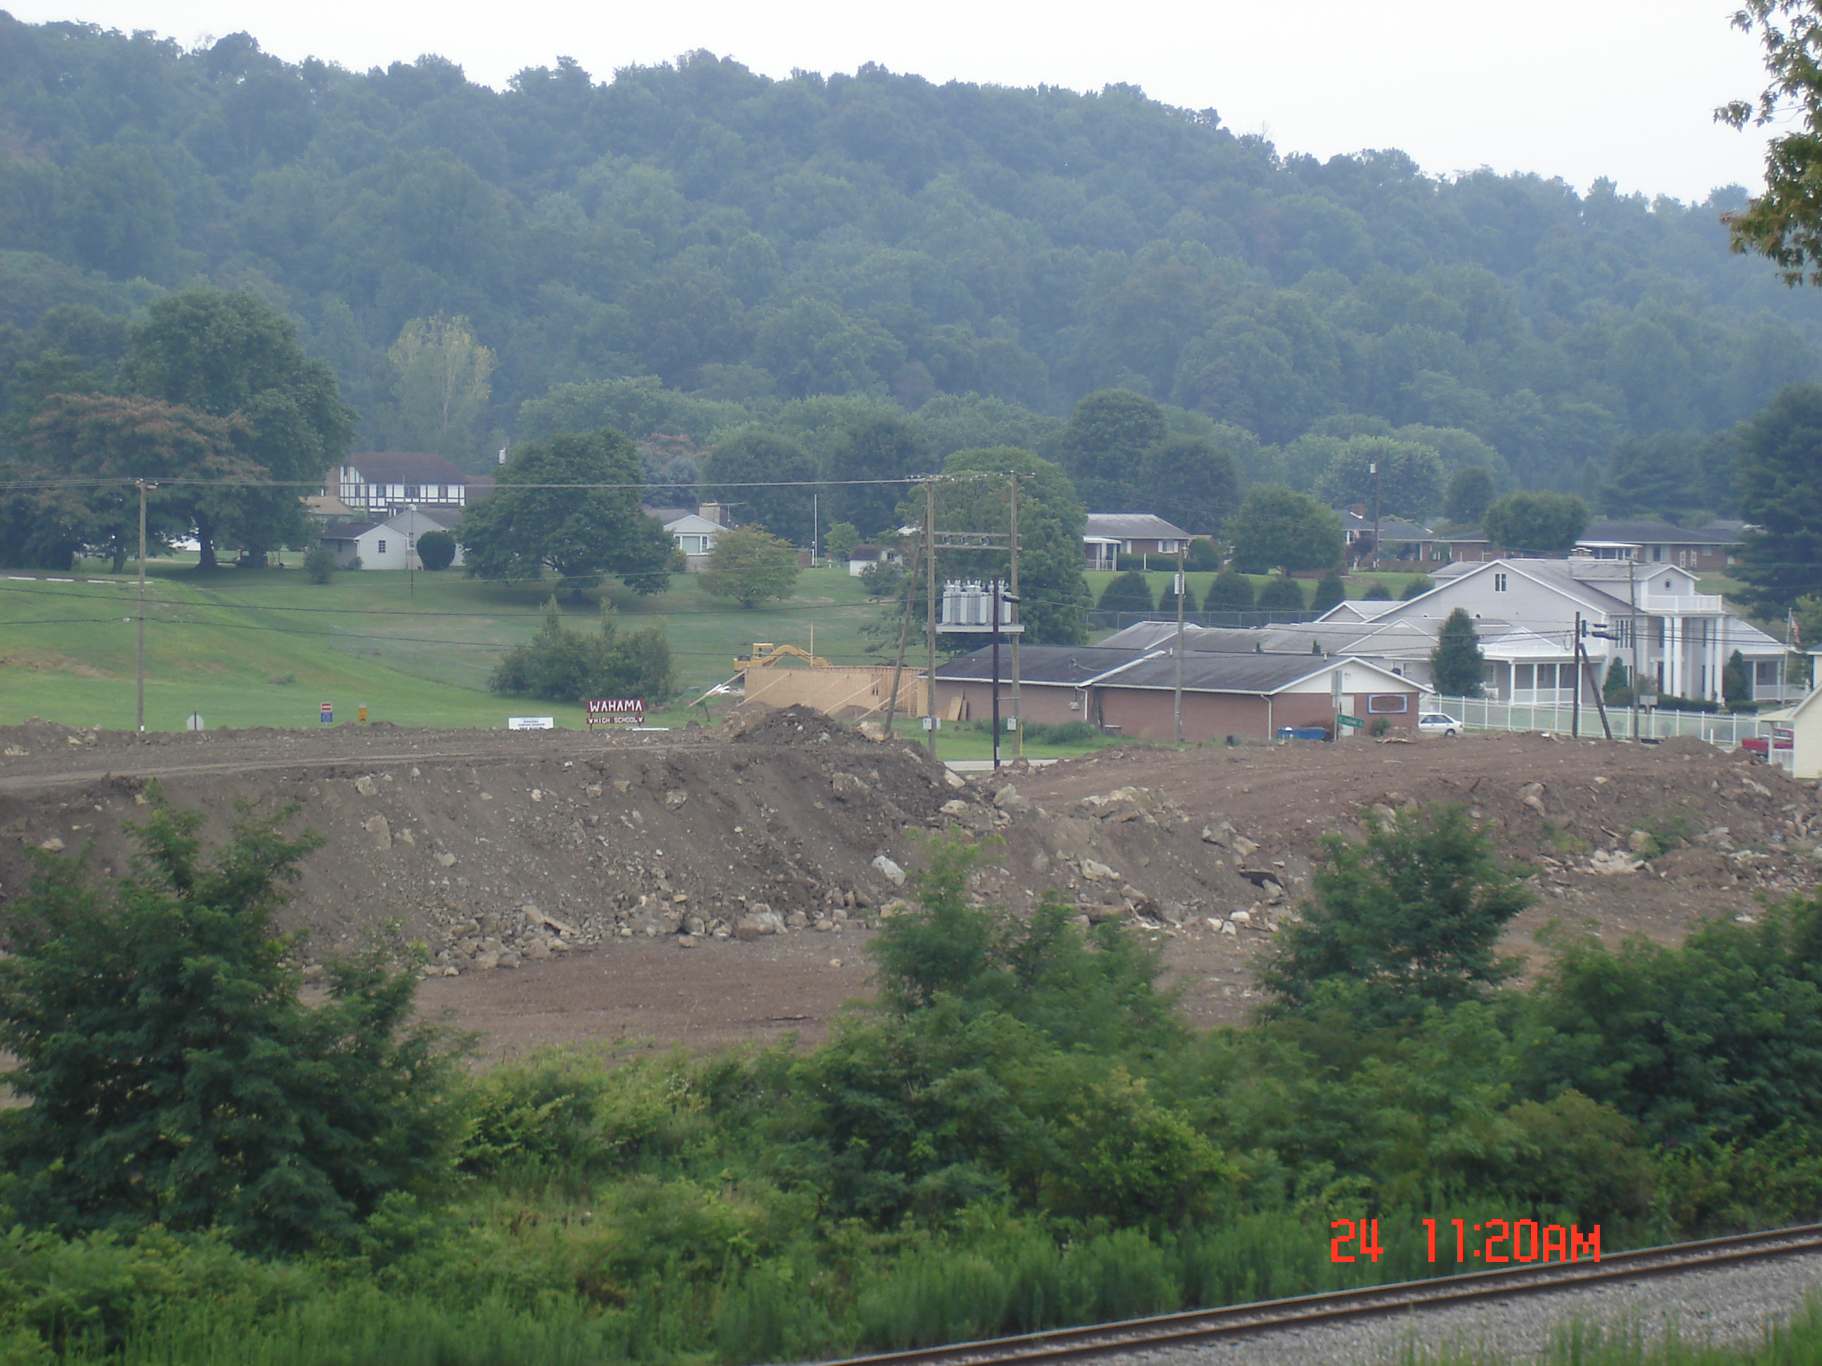
SS 832 and CMS 107.10- Work outside the project work limits
Although not currently included in permit applications “borrow and waste sites” are subject to the Clean Water Act (Section 401/404).
Agencies are pushing ODOT to incorporate borrow and wastes sites into NEPA documents and permitting documents.
ODOT Contractors are required by CMS 107.10 to have a pre-qualified consultant certify that borrow and waste sites will not impact jurisdictional waters and isolated wetlands.

Slide 27
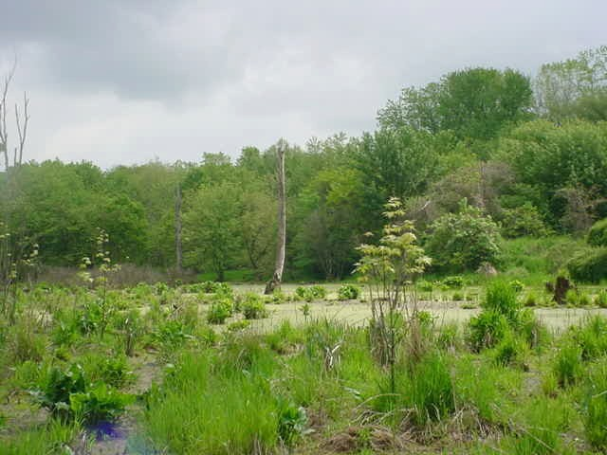
SS 832 and CMS 107.10- Work outside the project work limits
Pre-qualified consultant
  Wetland, ECO, ESA, CR, Floodplain, Haz
  Provide documentation to DEC and OES
Secure any necessary waterway permits.
  Could take 3-8 months.
Prior to using the area.

Slide 28
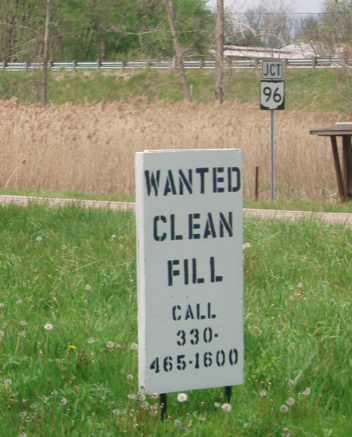
SS 832 and CMS 107.10- Work outside the project work limits
Use of land outside of existing ROW (including temporary work agreements, disposal of spoil on private land, etc.)
Beware of this sign!
Notes:
This is the current requirement in CMS. Some DEC's have indicated they are only clearing the proposed construction limits. This is something that should be addressed with DEC. They should be clearing resources R/W to R/W in the project area. Designers need to make sure all resources are listed on the plans. Many cases, the resources are not shown on the design plans if outside the construction limits.
In order to be covered by the project Construction General Permit, these borrow and waste areas need to be exlusive to the ODOT project. Otherwise, contractor will have to get a separate permit for this area.

Slide 29
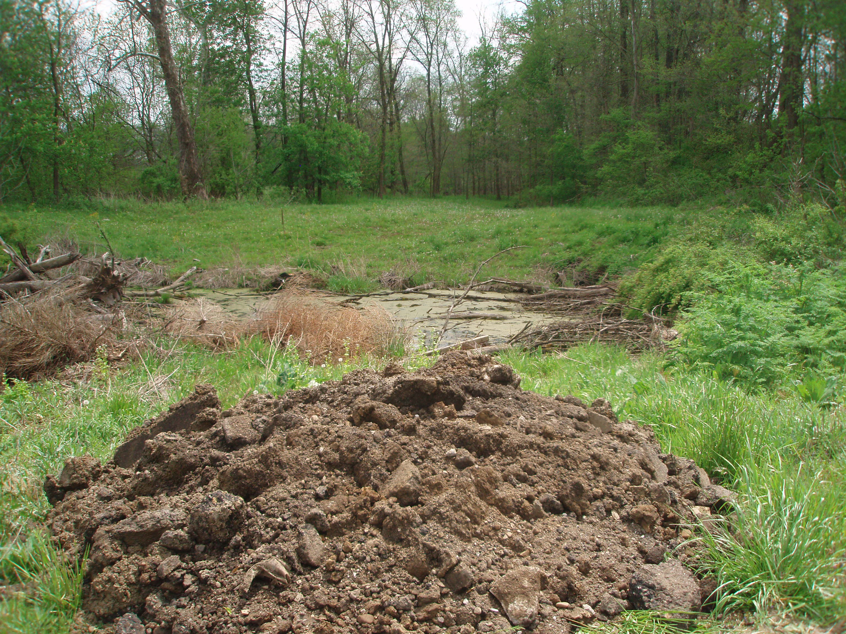

Slide 30
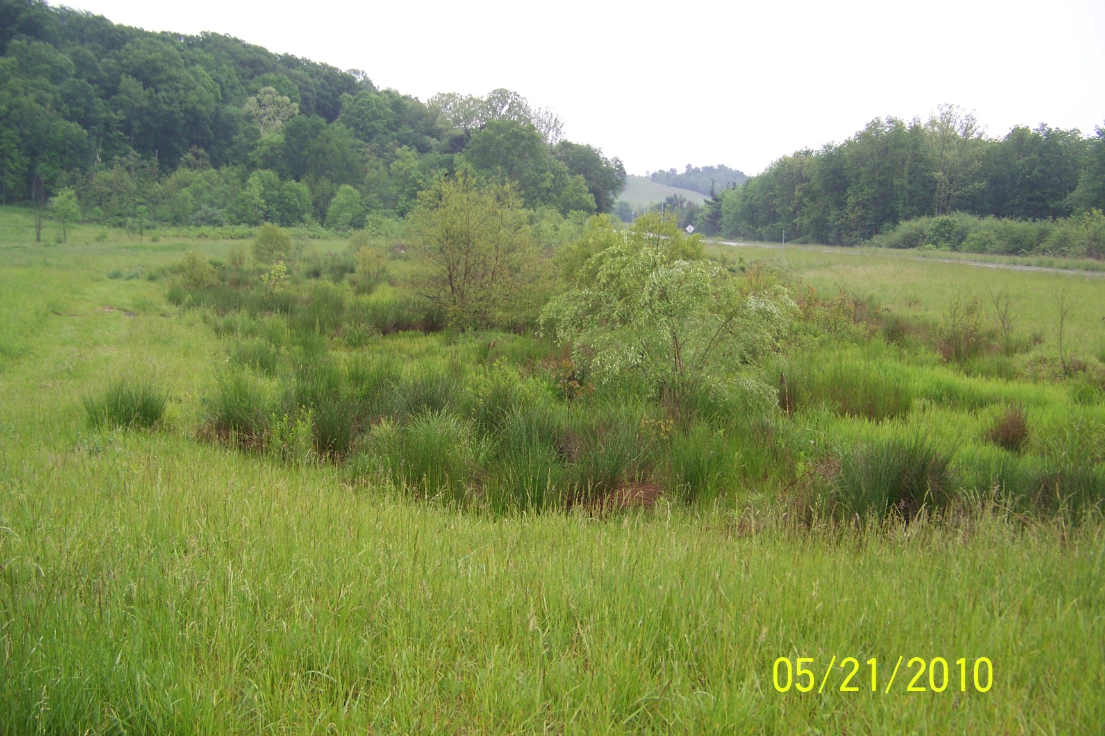
Wetlands
Depending on the situation, wetlands can be easy or extremely difficult to identify on the landscape. In this photo, the dramatic change in vegetation types and color are simple indicators of the possibility of a wetland being present. The yellow line indicates the boundary of the wetland. This boundary is the limit of the regulated area of the wetland. Activities that would impact this wetland within the yellow line require a permit. A “wetland delineation” is required for this site and necessary 404/401 permits before any fill can take place.

Slide 31
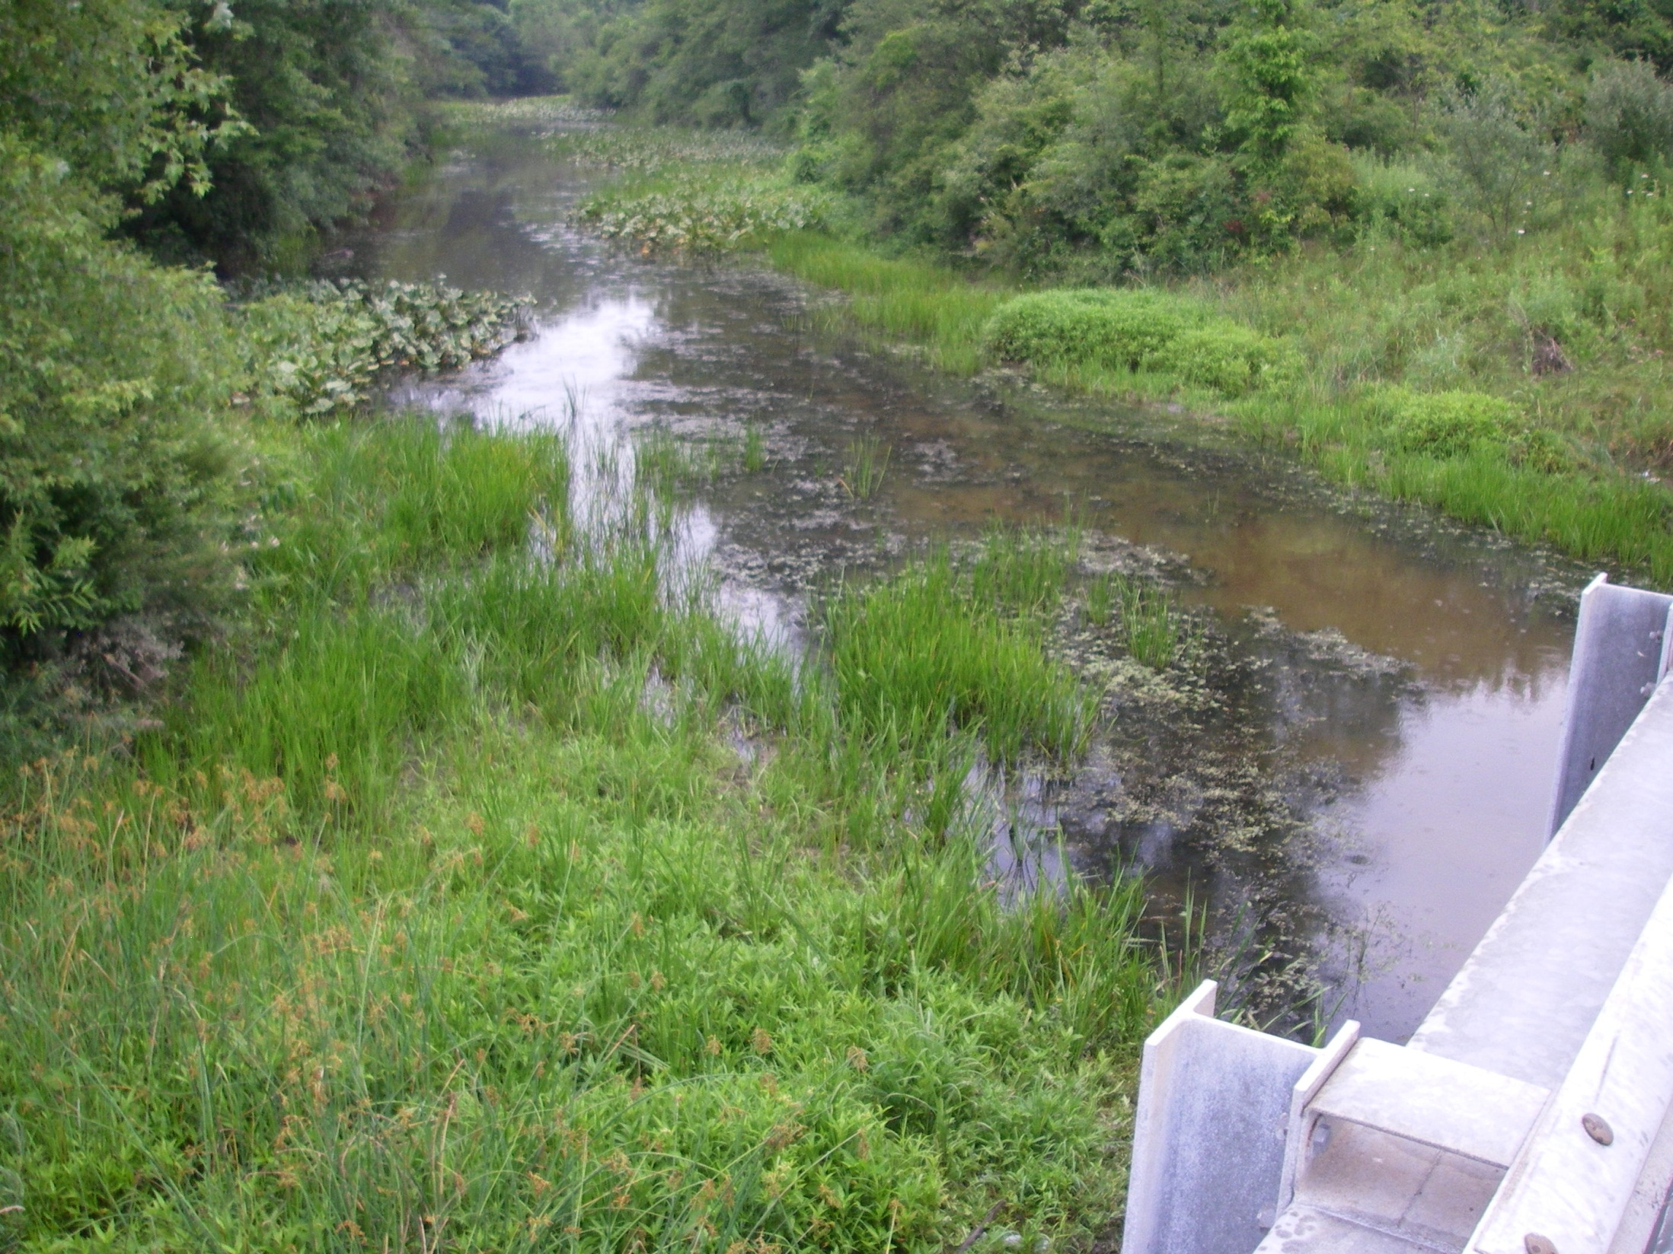
Wetlands
Regulated wetlands can often be within stream channels, and immediately next to bridges. Wetlands (vegetated areas within the yellow lines) are along and within the stream channel

Slide 32
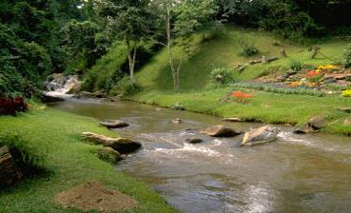
The cost of compliance:
Significant costs to ODOT and/or contractor. (Clean up or mitigation)
Possible loss of Federal funds.
More project oversight or new regulations.

Slide 33
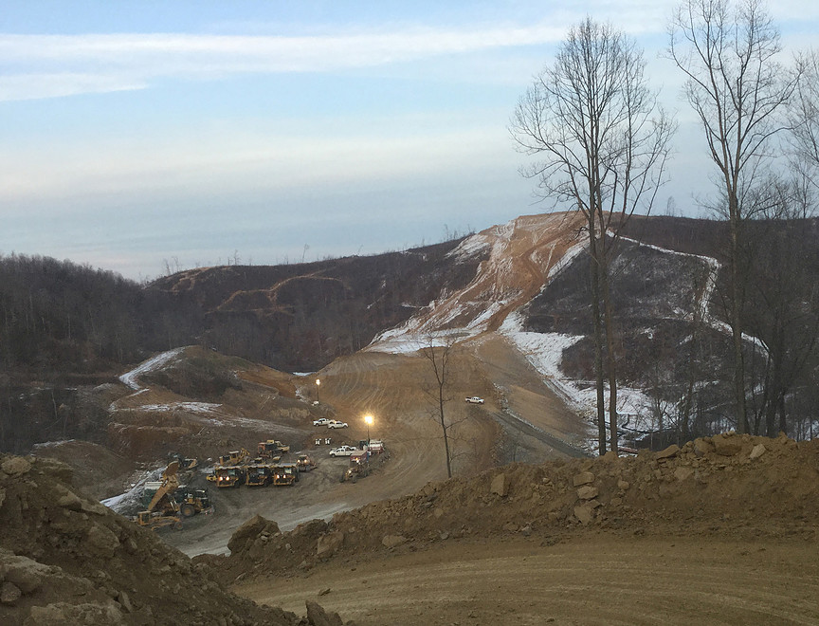
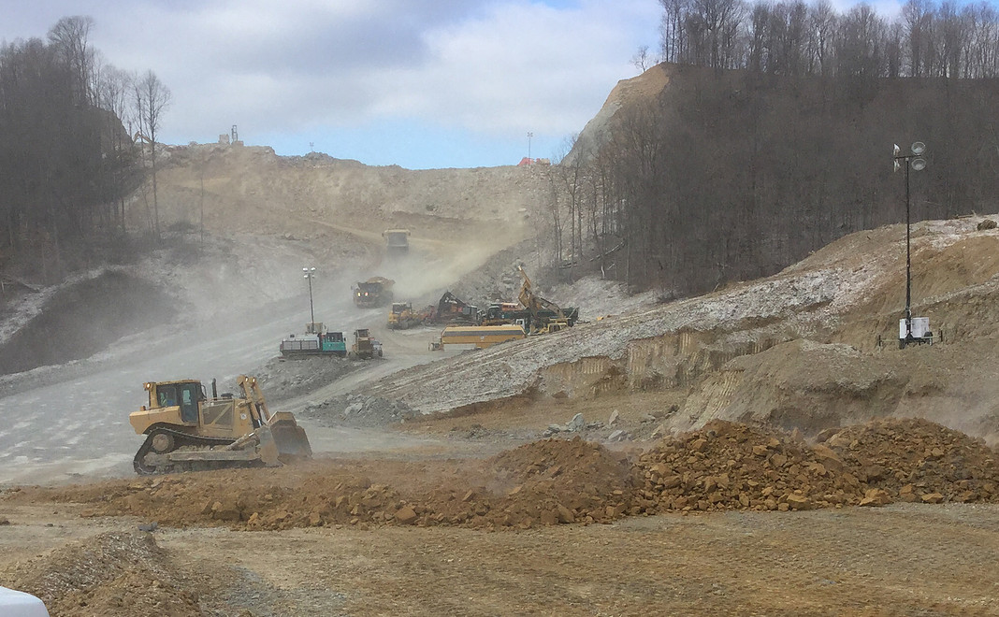
SCI-823-0.00 (PID 19415) Project Example

Slide 34
SCI-823-0.00 (PID 19415) Project Example
Project Impacts:
773 acres of forested habitat
  Suitable habitat for federally listed bats
77,360 linear feet of stream impact
10.42 acres of wetlands
Impact to two state endangered plant species
Impact to a known mussel bed at Little Scioto Creek

Slide 35
SCI-823-0.00 (PID 19415) Project Example
Environmental Commitments:
Seasonal clearing of all trees to avoid direct impacts to federally listed bat
  Separate tree clearing contract is necessary to meet schedule
Seasonal work restrictions on some streams
  No work in the water from April 15 to June 30 for any stream designated Class III PHWH or WWH.
Mussel survey and relocation on the Little Scioto River
  Estimated cost of $20,000
Rare Plant relocations to protected properties
  Done by ODOT-OES
No build zones to protect streams and wetlands within the right of way

Slide 36
SCI-823-0.00 (PID 19415) Project Example
Environmental Commitments:
Bat habitat conservation measures
  Protection of a minimum 773 acres of suitable forested habitat in perpetuity
  Estimated cost $7 million
Stream mitigation
  117,298 linear feet of streams preserved and/or restored at multiple sites
  Estimated cost $12.5-12.6 million
Wetland mitigation
  22.55 acres obtained from two wetland banks and an ODOT pooled mitigation area
  Estimated cost $1-1.1 million
Environmental compliance monitor
  Incorporated into the contract

Slide 37

Environmental Updates…
“Even if you are on the right track, you’ll get run over if you just sit there.” - Will Rogers
http://www.dot.state.oh.us/Divisions/Planning/Environment
Notes:
Will Rogers said this.

Slide 38
Contacts
Tim Hill, Environmental Administrator
(614) 644-0377
Tim.Hill@dot.ohio.gov
Matt Perlik, Assistant Environmental Administrator, Ecological/Waterway Permits/ESA
(614) 466-1937
Matthew.Perlik@dot.ohio.gov
Erica Schneider, Assistant Environmental Administrator, Policy & Cultural Resources
(614) 387-0134
Erica.Schneider@dot.ohio.gov

